Slide 1
Implementing 802.11ah in Software Defined Radio
Project carried out for ET4393: wireless networking
Danilo Verhaert
Delft University of Technology
Student number: 4234685

Slide 2
Introduction
Problem definition
Growing number of M2M devices (IoT)
Current protocols are interoperable, but not really power/range/speed efficient
Nodes always awake, large transmission window, high frequency
Solution
IEEE 802.11ah
Combining Wi-Fi and low-power network advancements
Lower energy on lower frequencies with higher range in comparison to conventional 802.11 standard
But better than 802.15.4?

Slide 3
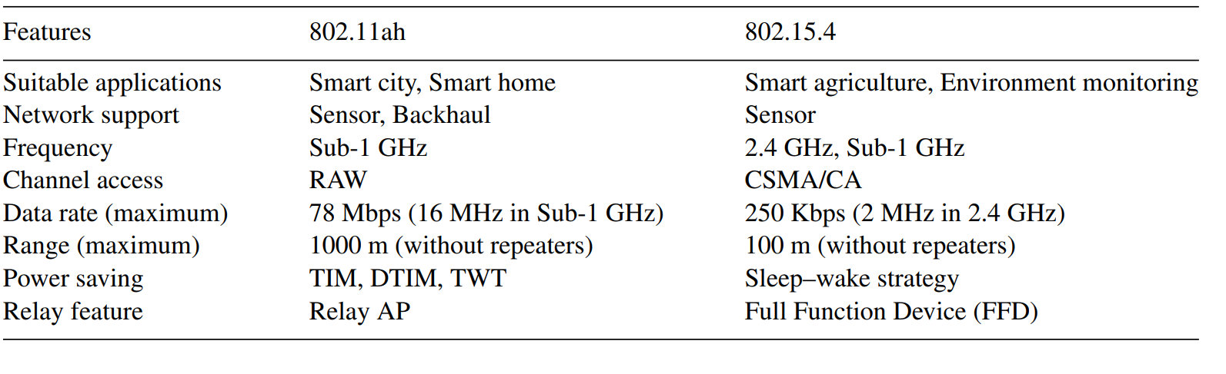
Comparison
Suited for large/widespread number of devices in comparison to 802.15.4, trading off a higher data rate and more range for some energy efficiency. Similar conclusion when comparing to Bluetooth Low Energy (BLE).
802.11ah vs. 802.15.4 [5]

Slide 4
Specifications
Sub-1GHz frequencies, 863-868 MHz for EU and 902-928 MHz for US
Transmit data by varying frequency, amplitude and phase
Orthogonal Frequency Domain Multiplexing (OFDM)
Quadrature Amplitude Modulation (QAM)
Bandwidths of 1 and 2 MHz (some countries also 4, 8 and 16)
Traffic Indication Map (TIM)

Slide 5
Approach
GNU Radio, open-source toolkit for Software Defined Radio
Use of USRP N210 SDR as a transceiver
Creating block diagram in GNU Radio, which creates, encodes, sends and consequently receives and decodes packets
Python as a binder

Slide 6
Approach
Important note is to choose a good basic framework, don’t reinvent the wheel
Base implementation of IEEE 802.11a/g/p used from [2]
Main things used are encoding 802.11 PHY and MAC layer
Edited and new blocks added for IEEE 802.11ah

Slide 7
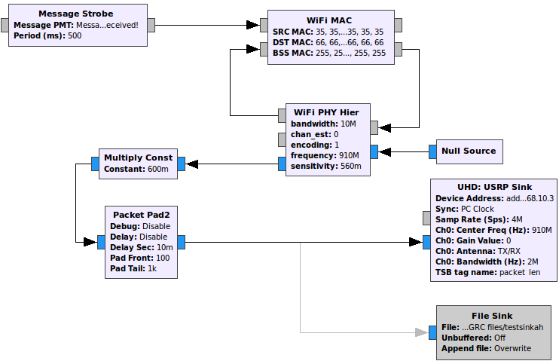
Implementation: transmitter

Slide 8
Implementation: transmitter
Generating messages every half a second
Encapsulate this in the MAC layer by adding source, destination and BSS MAC
Encapsulate this in the PHY layer (OFDM) by:
Using channel estimation of choice to improve the bit error rate (LS, LMS, STA)
Applying encoding type of choice (BSPK, QPSK, QAM)
Fine-tuning gain, padding bursts with zeroes and finally transmitting the packet with the USRP N210.

Slide 9
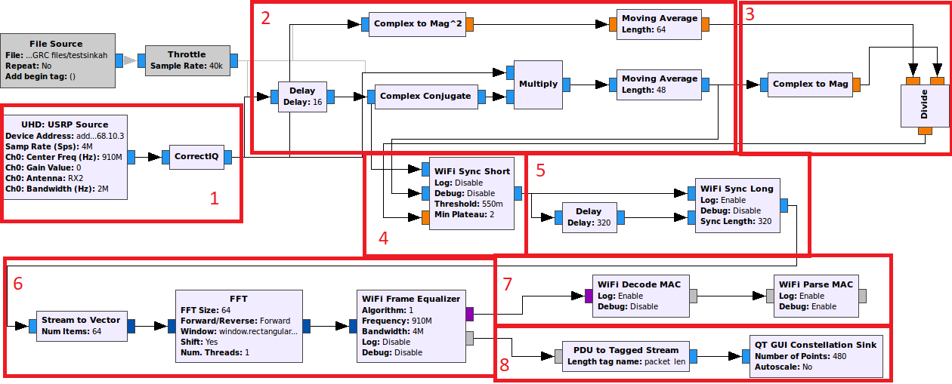
Implementation: receiver

Slide 10
Implementation: receiver
1: Receive packets with the USRP N210 and apply IQ correction
2: IEEE 802.11ah frames start with 16 sample pattern repeating 10 times. Therefore, to detect the start of a frame, compute autocorrelation with lag 16, and sum over a window (moving average). If this is near 1, we can assume a frame has started. Note that the difference in MA lengths is due to the earlier introduced delay.
3: Normalize autocorrelation by dividing the it with the average power
4: Threshold which will send USRP samples through if the normalized autocorrelation is above a certain threshold, and drops otherwise (short training sequence)

Slide 11
Implementation: receiver
5: Frequency offset correction and symbol start estimation using the cyclic prefix of each OFDM symbol (long training sequence)
6: Conversion to frequency domain and correcting for small inequalities in phase/magnitude
7: Decoding of the BPSK modulated OFDM signal, containing the length and encoding type of the corresponding data packet
8: Decode signal and map received points in the IQ plane

Slide 12
Contribution
Adapted for 802.11ah by changing frequencies, sampling rates and other such parameters
Reduced the effect of local oscillator leakage by adding default LO leakage offset of 6 MHz
Added custom block which corrects for IQ DC spike. It does so by calculating a weighted average over ongoing samples and subtracting that from future ones
Adjusted several variables for better reception (threshold values, sampling rates, sync lengths, window size, channel bandwidth, gain settings etc)
First working prototype of a 802.11ah transceiver on USRP N210

Slide 13
Results: see video!
LMS works best for encoding
Smallest amount of packet loss with a high rate of error correction (e.g. ½) and a lower symbol rate (e.g. BPSK ½)
Higher symbol rates/lower error correction rates also work, but some losses visible
Best sample rate 4 MHz

Slide 14
Challenges on the way
Lots of struggles, unfortunately not very well documented… this should change
My struggles: setting up VirtualBox with bridged ethernet adapter, downloading custom blocks in GNU radio and making these work with incompatible versions (e.g. different/outdated branches on github) by performing many ‘interesting’ sudo commands, reflashing the firmware of the USRP N210, seeing overflow messages to find out ethernet connection with a VM not fast enough, installing everything on a desktop, installing Windows to update firmware of ethernet driver, seeing that this overwrote bootloader so reinstalling everything again, finding another USRP N210, through intense debugging and going back to basics finding out that the power adapter of all things was delivering a lower voltage which made one USRP N210 malfunction while the other actually didn’t work, using this basic working transceiver constructing and optimizing 802.11ah transceiver by trying many other blocks, parameters and antenna configurations for better data reception, in the end finally making it all work!

Slide 15

Conclusion
802.11ah: low-energy and high range protocol
Working 802.11ah prototype in GNU Radio achieved!

Slide 16
References
[1] Adame, Toni, et al. "IEEE 802.11 ah: the WiFi approach for M2M communications." IEEE Wireless Communications 21.6 (2014): 144-152.
[2] Bloessl, Bastian, et al. "An IEEE 802.11 a/g/p OFDM Receiver for GNU Radio." Proceedings of the second workshop on Software radio implementation forum. ACM, 2013.
[3] Barve, Ashwin, et al. "Implementing 802.11 ah–The Sub-1 GHz Wi-Fi Standard." (2016).
[4] Aust, Stefan, R. Venkatesha Prasad, and I. G. M. M. Niemegeers. "Advances in wireless M2M and IoT: Rapid SDR-prototyping of IEEE 802.11 ah." the Proceedings of the 39th IEEE Conference on Local Computer Networks (LCN), Demo Abstract. 2014.

Slide 17
References
[5] Ahmed, N., H. Rahman, and Md I. Hussain. "A comparison of 802.11 ah and 802.15. 4 for IoT." ICT Express 2.3 (2016): 100-102.
[6] Narendra, PrithviRaj, Simon Duquennoy, and Thiemo Voigt. "BLE and IEEE 802.15. 4 in the IoT: Evaluation and Interoperability Considerations." International Internet of Things Summit. Springer, Cham, 2015.
[7] Li, Ye Geoffrey, and Gordon L. Stuber, eds. Orthogonal frequency division multiplexing for wireless communications. Springer Science & Business Media, 2006.
And countless other sites (especially stackexchange) for helping me debug, thank god for that!

